Slide 1
Team 1
Medilink ER Diagrams

Slide 2
Team 1 : Medilink List of Entities
Entity Name | Entity Primary Attributes
patient | patient_user_name, first_name, middle_name, last_name, email, phone, age, gender, password, street_address, city, state, zip_code
doctor | doctor_user_name, email, full_name, licence_number, phone, specialization_name, password
health_report | report_id, report_data, report_name, uploaded_date, patient_user_name, doctor_user_name
payment | payment_id, subscription_id, advertisement_id, payment_date, payment_method, amount
subscription | subscription_id, patient_user_name, created_date
advertisement | advertisement_id, advertisement_title, advertisement_content, advertisement_start_date, advertisement_end_date
customer_support | support_id, patient_user_name, doctor_user_name, query_title, query_content, query_date, query_status, query_resolution_date

Slide 3
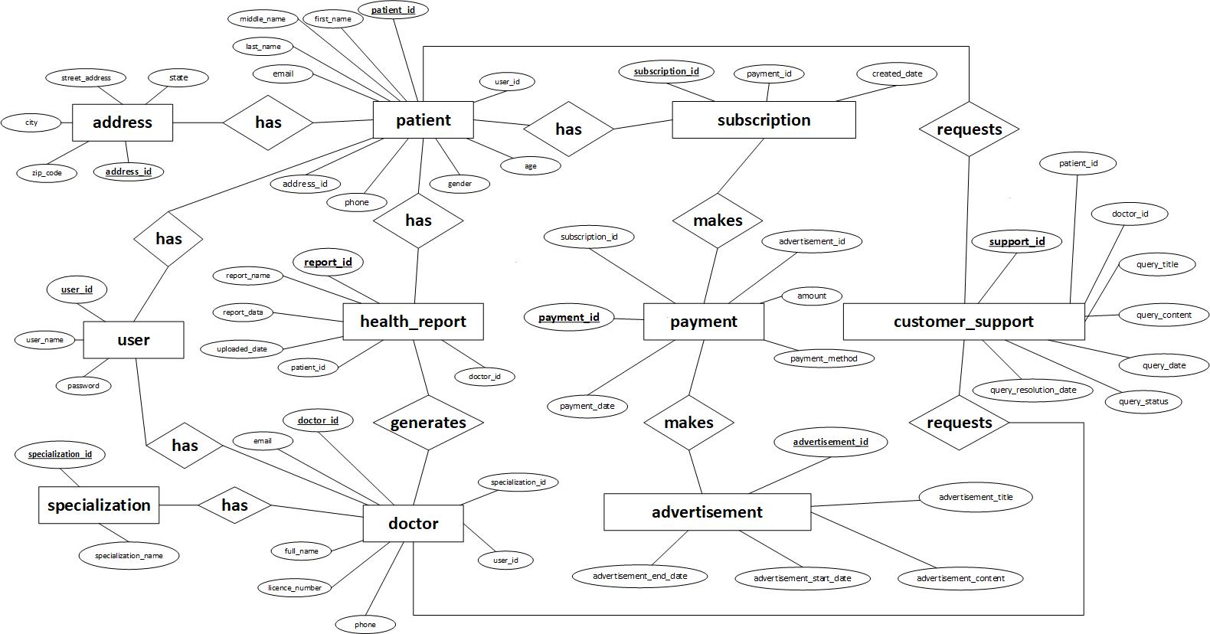
Team1 : Medilink Conceptual ER Diagram

Slide 4
Team 1 : Medilink Logical ER Diagram

